Slide 1
BOOK A DOCTOR USING MERN
TEAM ID:09959
TEAM MEMBERS:
TILAK KUMAR SAI NITHI (211521104172)
PAVITHRA N (211521104104)
RAKSHNA P(211521104122)
GETSY JACINTH S(211521104043)

Slide 2
TABLE OF CONTENTS
ABSTRACT
INTRODUCTION
PROPOSED SYSTEM
IMPLEMENTATION:MERN STACK
FRONTEND
BACKEND
INTEGRATION
BLOCK DIAGRAM
MODEL SCREENSHOT
CONCLUSION

Slide 3
ABSTRACT
The "Book a Doctor" system is a web-based platform designed to streamline the process of finding and booking medical appointments. This platform allows patients to search for doctors based on various criteria such as specialty, location, and availability, and book appointments in real-time. It provides comprehensive doctor profiles, enabling users to make informed decisions based on qualifications and reviews. The system ensures ease of use with features like user registration, appointment tracking, notifications, and secure online payments. Administrators can manage doctor schedules, monitor appointment trends, and optimize resource allocation. The system leverages the MERN stack (MongoDB, Express.js, React.js, and Node.js) for efficient and scalable development, offering a seamless and responsive experience for both patients and healthcare providers.

Slide 4


Introduction to Book a Doctor
Book a Doctor is a cutting-edge healthcare platform that revolutionizes the way people access and manage their medical care. By seamlessly integrating the power of the MERN stack, this innovative application empowers users to conveniently book appointments, connect with healthcare professionals, and manage their medical records all from the comfort of their own devices.

Slide 5
PROPOSED SYSTEM
Seamless Appointment Booking
1
Book a Doctor's user-friendly interface allows patients to quickly search for available healthcare providers, view their schedules, and book appointments that fit their personal needs and preferences.
2
Comprehensive Medical Records
Patients can securely access and manage their complete medical history, including lab results, prescriptions, and past visit summaries, all in one convenient online platform.
Telehealth Consultations
3
Book a Doctor integrates seamless video conferencing capabilities, enabling patients to consult with their healthcare providers remotely, reducing the need for in-person visits and improving access to care.
4
Personalized Notifications
Patients receive timely alerts and reminders about upcoming appointments, test results, prescription refills, and other important healthcare-related updates, ensuring they stay informed and engaged with their well-being.

Slide 6
IMPLEMENTATION:MERN STACK
FRONTEND
Frontend – React.js
User Interface: Build a dynamic and responsive UI for users to search for doctors, view profiles, and book appointments.
State Management: Use React's state and hooks to manage user interactions, form inputs, and real-time updates.
Routing: Implement client-side routing for seamless navigation between pages (e.g., homepage, doctor listings, appointment booking).

Slide 7
BACKEND
Backend – Node.js with Express.js
RESTful API: Develop backend services to handle requests such as user registration, login, appointment booking, and notifications.
Authentication & Authorization: Secure user access with JWT (JSON Web Tokens) for protected routes like booking and profile management.
Business Logic: Handle appointment scheduling, doctor availability, and payment processing.

Slide 8
Database – MongoDB
Data Storage: Store user profiles, doctor details, appointment records, and feedback in a NoSQL database for flexible and scalable data management.
Real-Time Updates: Enable real-time booking updates and status changes using MongoDB’s document-based structure.
Data Security: Ensure secure storage of sensitive user data, including medical history and payment details.

Slide 9
Full-Stack Integration
APIs and Frontend-Backend Communication: Use Axios or Fetch API to connect the frontend with backend services, ensuring smooth data flow.
Real-Time Notifications: Implement email or SMS notifications using third-party APIs like Twilio for appointment reminders and updates.
Deployment: Deploy the system on cloud platforms like AWS or Heroku, ensuring continuous availability and scalability.

Slide 10
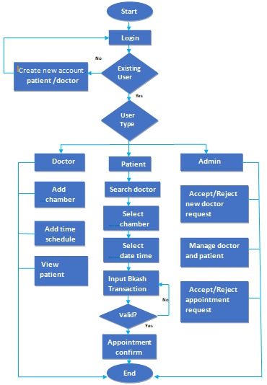
BLOCK DIAGRAM

Slide 11
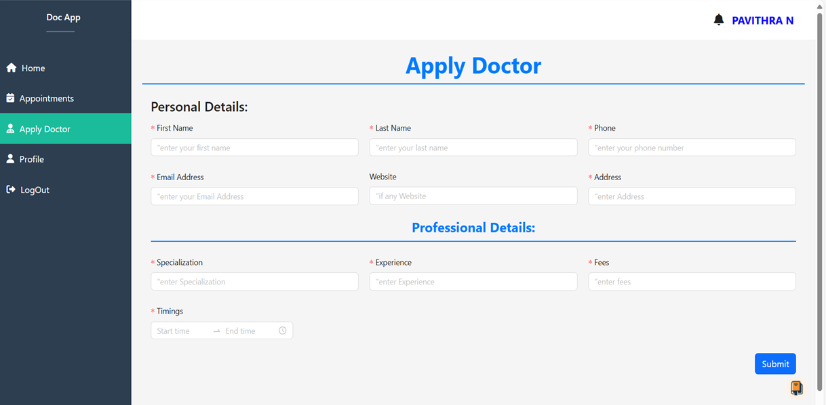
MODEL SCREENSHOT

Slide 12
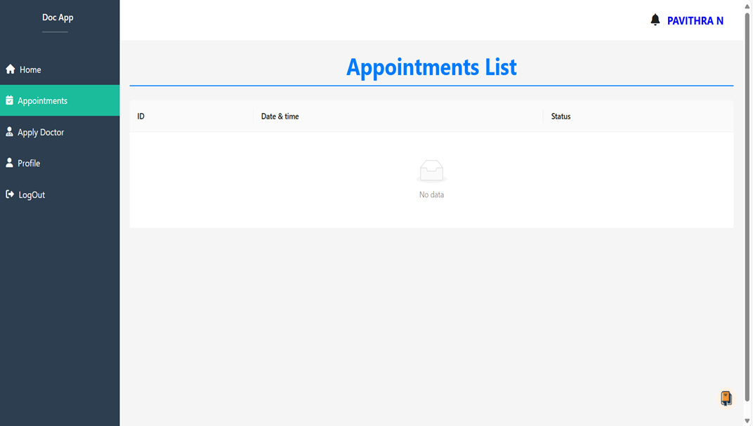

Slide 13

Conclusion and Next Steps
Book a Doctor, powered by the robust MERN stack, is revolutionizing the healthcare industry by providing patients with a seamless, convenient, and secure platform to manage their medical care. By seamlessly integrating the strengths of MongoDB, Express.js, React.js, and Node.js, Book a Doctor delivers a cutting-edge user experience that empowers patients to take control of their health and well-being.
As the platform continues to evolve, the team at Book a Doctor is already exploring exciting new features and improvements, such as incorporating AI-driven personalized recommendations, integrating wearable health data, and expanding the telehealth capabilities to reach more patients in underserved communities. With its innovative approach and commitment to enhancing healthcare access and outcomes, Book a Doctor is poised to become the go-to solution for individuals seeking a modern, efficient, and user-centric healthcare experience.

Slide 14
THANK YOU!

